Slide 1
Joins and Views
If you look at the Entity Relationship diagram (ER) for the chinook data set on the next page, you will notice that the information is kind of spread out.
If we look a “track” we might be interesting in knowing what album the track came off of, but it doesn’t tell us that, it just tells us the albumid. Why?
Edgar Codd worked out a lot of ideas about how data should be separated and stored for maximum storage efficiency and for robust maintenance, he really developed the ideas behind relational databases. Many tracks come from each album, so we should store the album information only once per album, and then use the relationship between tracks and albums to find keep track of this information.

Slide 2
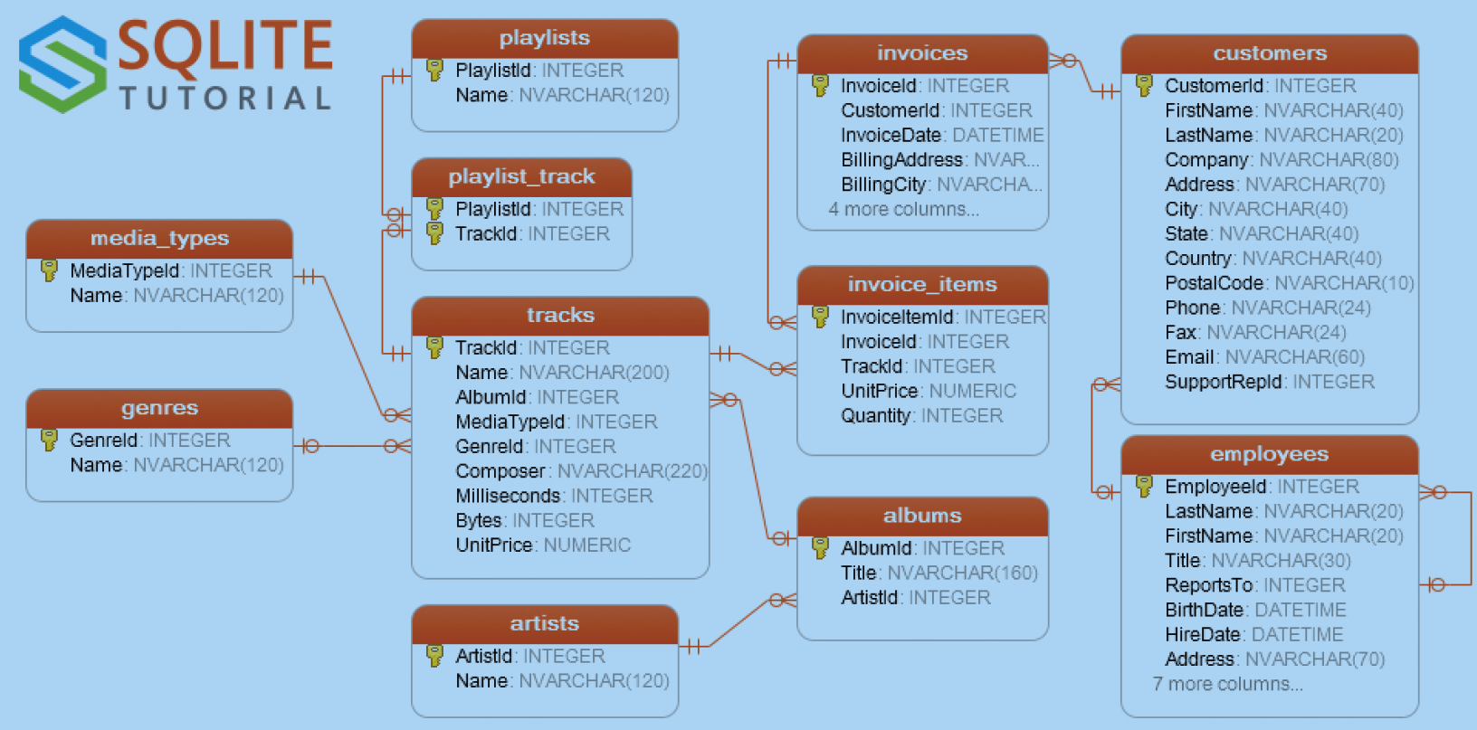
But the separation of data means that the information we need may be spread over several tables
Note: This is the Sqlite version of chinook, names differ slightly from the Postgres version, mostly in capitalization
We’ll see this table again, there is a lot of info here- arrows indicate relationships

Slide 3
Why separate data so much?
-Avoiding conflicting information. We might have an error in the Album name, that might occur in one track but
not others. If we tried to create a list of all our albums that would cause an error.
-Maintenance- if we wanted to fix that typo, we would have to go through all the tracks and check them if the
album name was stored with each track.
When we start talking about database design and using normal forms, we will talk more about how this works.
We will often need to Join data tables together to combine information from multiple tables, to answer various questions we have.
There are 4 different types of Joins plus some other operations to combine data tables.

Slide 4
Joins
Joins are always between two data tables, the first is called the Left table and the second is the Right table
If we need to join 3 tables (A, B,C) we join A+ B and then (A+B)+C. Not a big deal
Databases are joined by selecting values from both tables when the rows have matching values in the specified join variables. This will become easier to understand when we look at some examples
There are many types of joins, the main 5 are
Inner- select rows where the join condition is true for both Left and Right tables. If either Left or Right is missing, drop
the row.
Left join- for each join condition in the left table, show the row, using the right values or NULL as needed. If the row
exists in Left, but not Right, add in Nulls. Each row in the Left table will appear in the Join
Right join-The mirror image of a left join- for each join condition in the right table, show the row, using the left values or
NULL as needed. If the row exists in Right, but not Left, add in Nulls. Each row in the Right table will appear in
the Join
Full Outer Join- Return all rows in both Right and Left, joined when possible and filled with NULLs otherwise
Cross Join- For each row in the Left, add each row in the Right, so the size is the product of the size of the two. Seldom
used!

Slide 5
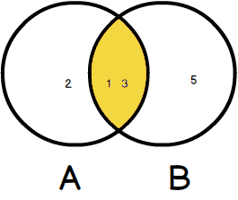
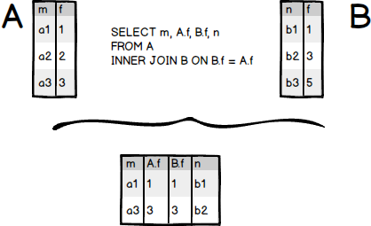
Inner Join Example
A is the Left, B is the Right, we are showing an inner join on the Join Condition (B.f=A.f), where A.f means column f in table A
The Venn diagram shows the condition for the row to show up in the join, specific A.f and B.f values must be in both tables
https://www.sqlitetutorial.net/sqlite-inner-join/

Slide 6
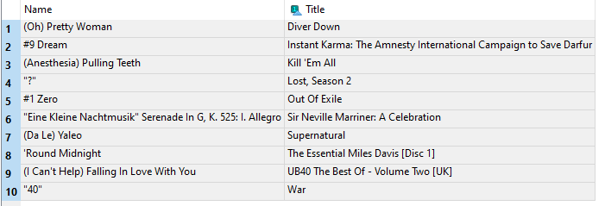
Example Inner Join, chinook database
SELECT Name,Title FROM
tracks
INNER JOIN albums on tracks.Albumid=albums.AlbumId
ORDER BY Name
LIMIT 10;
I ordered these by the Name of the track, and limited it to the first ten tracks
If this isn’t ordered by track, the first 10 are all from the same album, making it hard to see what is happening
We would use this if we want all information possible from the two databases.
Knowing where the NULLS appear might help find missing entries.
Note difference in the capitalization of names from the postgres version, this is the Sqlite version

Slide 7
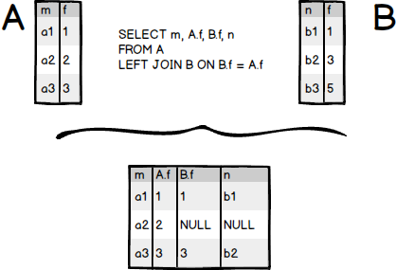
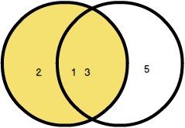
LEFT JOIN example from the SQLite tutorial-
A
B
All rows in A appear in the join, note that
One row has a null for data missing in B, and there is one row n B (B.f=5) that doesn’t appear in the join
Here’s the Venn diagram for the condition for rows to appear in the Left Join, you have to be in A and you can be in B, but elements only in B do not appear.

Slide 8
Right JOIN example
A
B
2
1 3
5
All rows in B appear in the join, note that
One row has a null for data missing in A (B.f=5) , and there is one row in A (A.f=3) that doesn’t appear in the join
Here’s the Venn diagram for the condition for rows to appear in the Right Join, you have to be in B and you can be in A, but elements only in A do not appear.

Slide 9
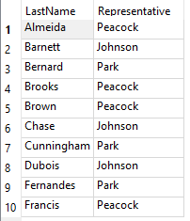
Left Join – a list of customers with their service representatives
SELECT customers.LastName, employees.LastName AS Representative FROM
customers
LEFT JOIN employees on customers.SupportRepID =employees.EmployeeId
ORDER BY customers.LastName
LIMIT 10;
I used a Left join, because I don’t carry about employees who don’t represent customers, so not all employees appear on this list, but all customers do
Notice that I used the AS operation in SQL to rename employees.LastName AS “Representative”, this makes the result easier to read

Slide 10
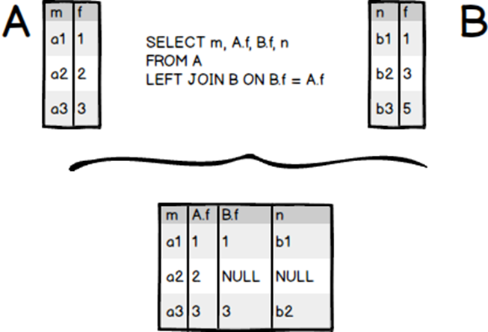
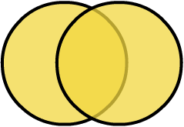
Full Outer Join
All rows in both tables are included in the Full Outer Join

Slide 11


Cross Join
A quick example based on cards, created in SQLite
CREATE TABLE ranks (
rank TEXT NOT NULL
);
CREATE TABLE suits (
suit TEXT NOT NULL
);
INSERT INTO ranks(rank)
VALUES('2'),('3'),('4'),('5'),('6'),('7'),('8'),('9'),('10'),('J'),('Q'),('K'),('A');
INSERT INTO suits(suit)
VALUES('Clubs'),('Diamonds'),('Hearts'),('Spades');

Slide 12
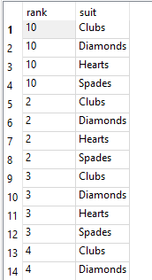
CROSS TABLE
Output shown for a limited number of values- the cross table shows all possible combinations from the two tables- How could we use this?
SELECT rank,suit
FROM ranks
CROSS JOIN
suits
ORDER BY rank;

Slide 13
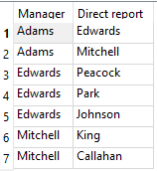
SELF JOIN
This joins a table to itself. This is useful when a table has information about relationships between entities in the same table. An employee table might list who each employee reports to (ie their boss), or perhaps the names of people’s children or spouse, who might also be in the same table
SELECT m.lastname AS 'Manager',
e.lastname AS 'Direct report'
FROM employees e
INNER JOIN employees m ON m.employeeid = e.reportsto
ORDER BY manager;
Lots going on here..
We have aliased employees as e
And also as m, so two aliases for the same table.
The we select the Inner join of the two and the manager name from m and the employee from e
Slick, the two alias allow use to treat one table as though it were two

Slide 14
Views
The output of a query is itself a table, we can save it as a table in fact.
But saving the output of a query as a table for later use has problems
-it doesn’t change if the underlying data changes
-we know have duplicated information stored and that is no bueno- hard to maintain
Instead we can create a View. A view is basically a stored query, we can view it by name and we can even run SELECT queries on it like it was a table. But the View stores the instructions on how to create it from tables, not the actual values. That’s a big advantage
If we alter data in a table (like employees, say), then if we look at the view again, the view will show the updated data, pulling it from the table for us.
Views are handy if we will need to run the query again later, or we want to make it accessible to others, or if we have to write a really complex query.
Don’t store a query result as a table! Ever! Use a View

Slide 15

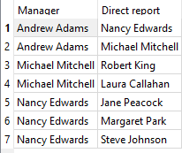
View Example
Creating a view of the management roles at chinook
CREATE VIEW ManagementRoles AS
SELECT m.firstname || ' ' || m.lastname AS 'Manager',
e.firstname || ' ' || e.lastname AS 'Direct report'
FROM employees e
INNER JOIN employees m ON m.employeeid = e.reportsto
ORDER BY manager;
SELECT * FROM ManagementRoles;
We could ask- who is Robert’s manager?
SELECT * FROM ManagementRoles
WHERE Direct_report LIKE '%Rob%';
We can use SELECT on a view, and delete it, or use it in queries, but we can’t add data to it or edit its properties

Slide 16
Joins and Run Time
Joins are computationally expensive on large databases, they take a lot of time to run
Be aware of that before you run a large join on a big database. Some companies only run large queries at night, when there are fewer users and fewer transactions.
It is not uncommon to have operational databases and developmental databases running in a large organization
All the code testing is done on the developmental database, to avoid problems on the operational database that might harm the organization.
The developmental database is typically a copy of the operational database, which may not be slightly older (by days or weeks, not years) than the operational database.
Some GUIs or SQL servers have the ability to time the length of a query, or one could do it in Python code. It is probably a good idea to do this, we will look at this using Python

